Slide 1
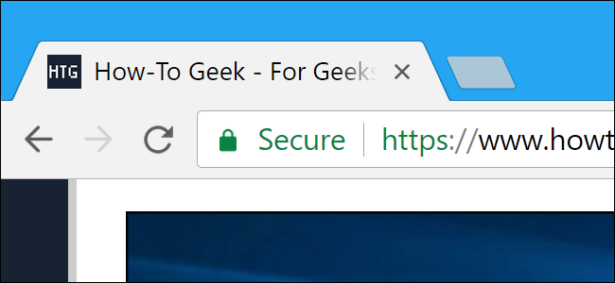
SSL & SSL Certificates Explained For Beginners
You already know this from NES, but if you forgot, here’s a reminder
http://www.steves-internet-guide.com/ssl-certificates-explained
Notes:
What does the S stand for in HTTPS? Secure ;)

Slide 2

Enabling HTTPS in .NET
To run your .NET apps via HTTPS on localhost, use the following command to trust the HTTPS development certificate that was installed alongside the .NET SDK
dotnet dev-certs https --trust
HTTPS in .NET

Slide 3

HTTPS in Java
Follow the next 4 steps if you want to use the same development certificate with your Java applications

Slide 4

Exporting the Certificate + Private key
1) Export cert+private key (.pfx file)
dotnet dev-certs https -ep "mypfxfile.pfx" -p password
NB! Remember to change file name and password

Slide 5

Importing the Keystore
2) Generate keystore from .pfx
keytool -importkeystore -srckeystore mypfxfile.pfx -srcstoretype pkcs12 -deststoretype pkcs12 -destkeystore C:\Users\USERNAME\.keystore -deststorepass password -destkeypass password
NB! Remember to change path and passwords

Slide 6
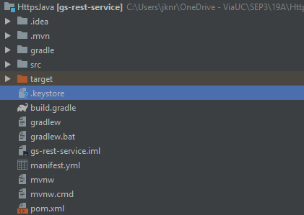
Adding the Keystore to our Java Application
3) Copy the generated .keystore file to the root of the Java application folder

Slide 7
Configure the Framework
4) Set up HTTPS according to your framework
E.g. for Java Spring an "application.properties" file can be created in src/main/resources containing the keystore information
server.port: 8443
server.ssl.key-store: .keystore
server.ssl.key-store-password: password
server.ssl.keyStoreType: PKCS12
server.ssl.keyAlias: {cede3e13-ccc7-413e-8617-3dbfc0da1078}
NB! Remember to change keyAlias and password

Slide 8
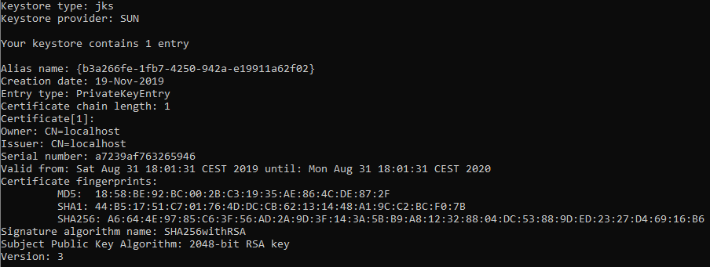
Inspecting the Keystore
You can inspect the keystore properties using the "keytool -list" command, e.g.
keytool -list -v -keystore .keystore
Your Java application should now be able to run via HTTPS on port 8443.

Slide 9

Add the Certificate to the Truststore
If your Java application is acting as a client towards one of your .NET applications, you also have to make your Java applications trust the certificate. This can be done in the next two steps.

Slide 10
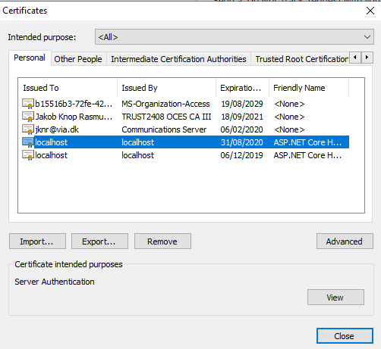

Exporting the Certificate
1) Export the localhost certificate from Google Chrome settings into a dotnet.cer file (settings > manage certificates > export...)
(Alternatively you can use Windows Certification Manager)
Notes:
run certmgr.msc (windows certification manager)

Slide 11
Importing the Certificate
2) Import the certificate into cacerts:
Determine the location of the cacerts file, e.g. C:\Program Files\Java\jdk1.8.0_191\jre\lib\security\cacerts
Import the dotnet.cer file into cacerts
keytool -import -keystore "C:\Program Files\Java\jdk1.8.0_191\jre\lib\security\cacerts" -file dotnet.cer -alias alias
NB! Remember to change alias. You will be asked for password which by default is 'changeit'
Notes:
cacerts is a truststore used to authenticate peers

